Slide 1
Human activity recognition with mobile sensing
Sanam Gorgannejad
Final project
Data science short course
General assembly
April 2024

Slide 2



DATA OVERVIEW AND Problem Statement
Dataset:
MotionSense Dataset : Smartphone Sensor Data – HAR
(https://www.kaggle.com/datasets/malekzadeh/motionsense-dataset)
This dataset includes time-series data generated by accelerometer and gyroscope sensors (attitude, gravity, userAcceleration, and rotationRate).
Given the sensor data, can we predict whether the person is walking, jogging, sitting, standing, upstairs, downstairs
Human activity recognition with mobile sensing
24 participants and 15 trials/participant → 360 total trials
X: 12 features from accelerometer and gyroscope sensors:
'attitude.roll', 'attitude.pitch', 'attitude.yaw', 'gravity.x',
'gravity.y', 'gravity.z', 'rotationRate.x', 'rotationRate.y',
'rotationRate.z', 'userAcceleration.x', 'userAcceleration.y',
'userAcceleration.z'
Y: 6 activity classes

Slide 3
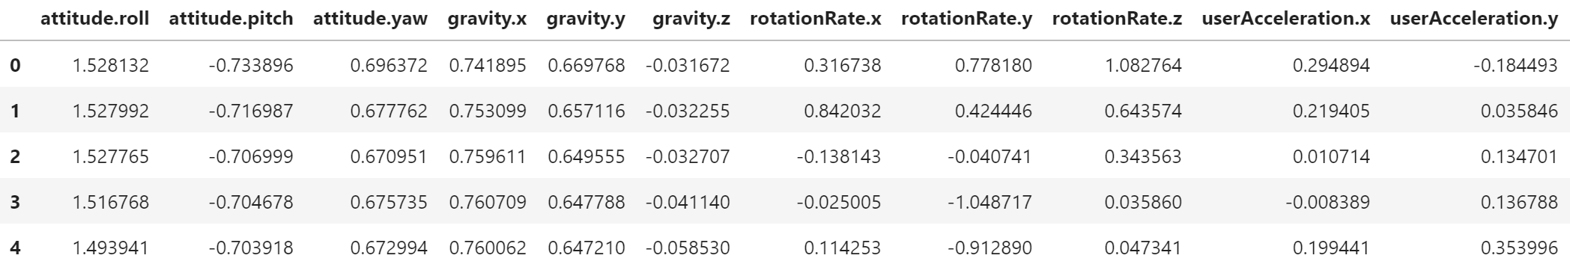
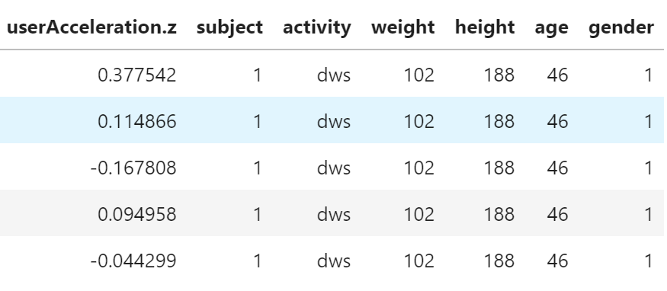
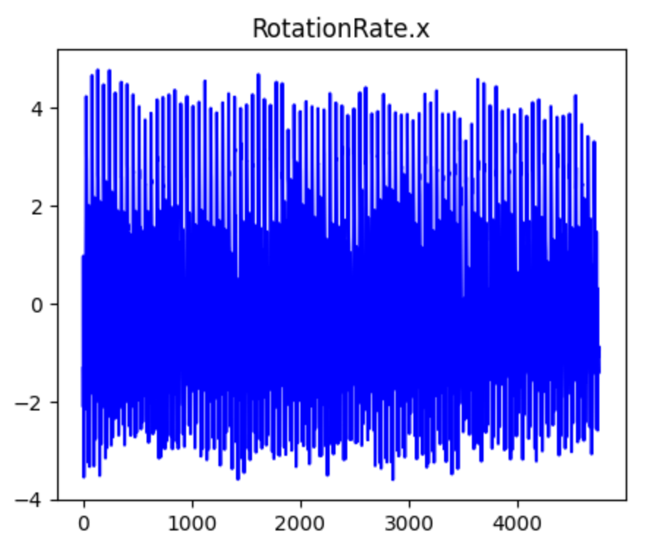
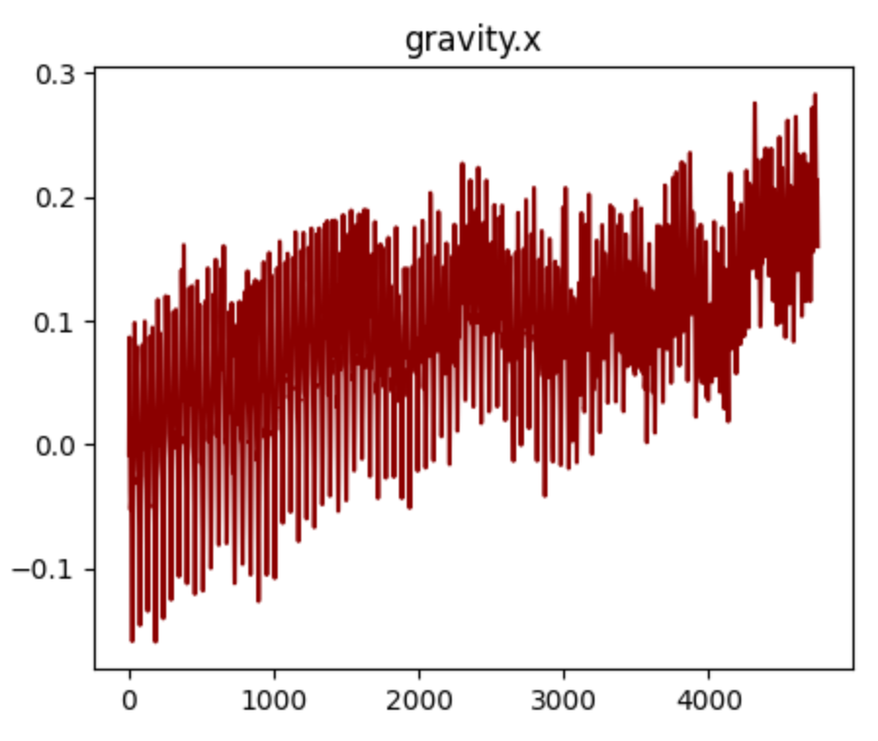
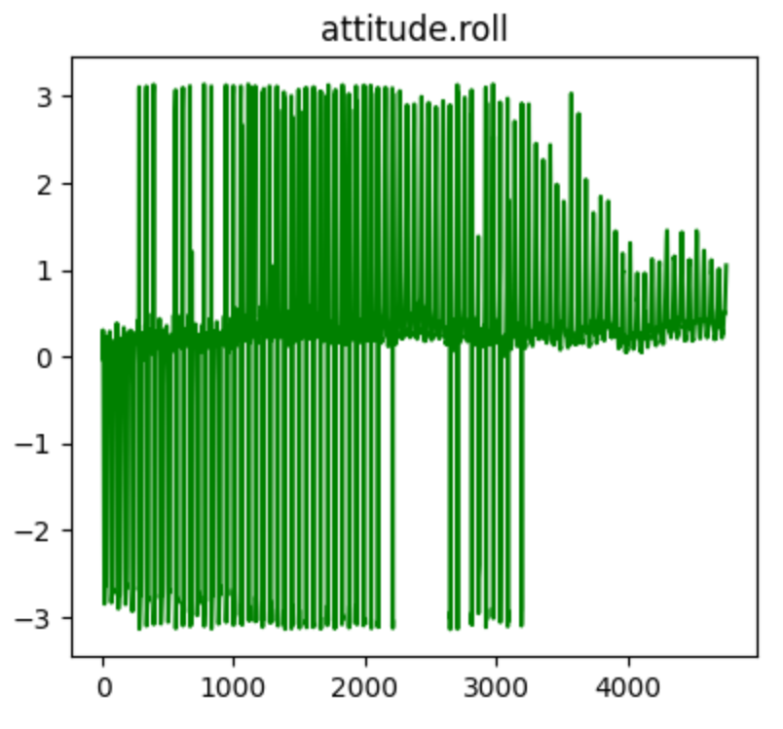
Exploratory data analysis
The features are timeseries sensor data
For simplicity, the participant information was not incorporated in predictions

Slide 4
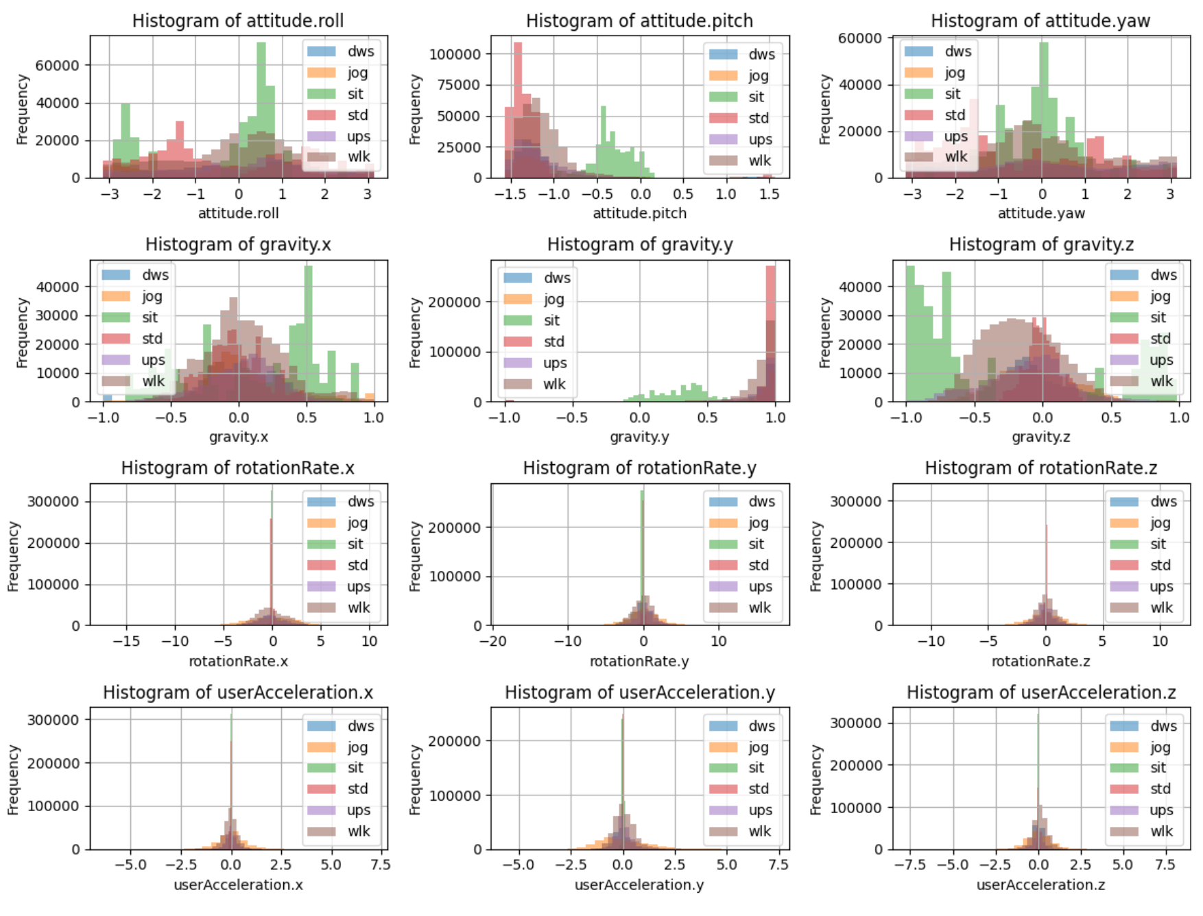
Features
This is the histogram of the distribution of features for different type of activities.
No null in the dataset – all features are floats
No categorical feature
The x axis of the histogram plots shows that features are at different ranges. This highlights the necessity to normalize the sensor data before training the model.
The first two row feature show differentiation between the distribution of the signals, this is not detectable qualitatively for the last two rows

Slide 5
Approach (I) for model development
Data Preprocessing
X and y definition
Feature extraction
Hyper parameter tuning
Model development
Model evaluation
Merging csv files
Standardization
Mean and std
n_estimators
Max_depth
Random Forest
Accuracy
Confusion matrix
Classification report
Cross-validation

Slide 6
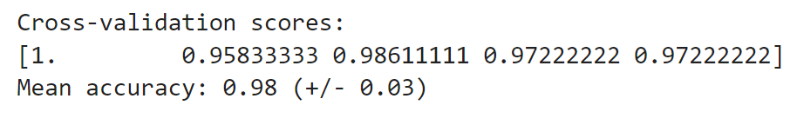
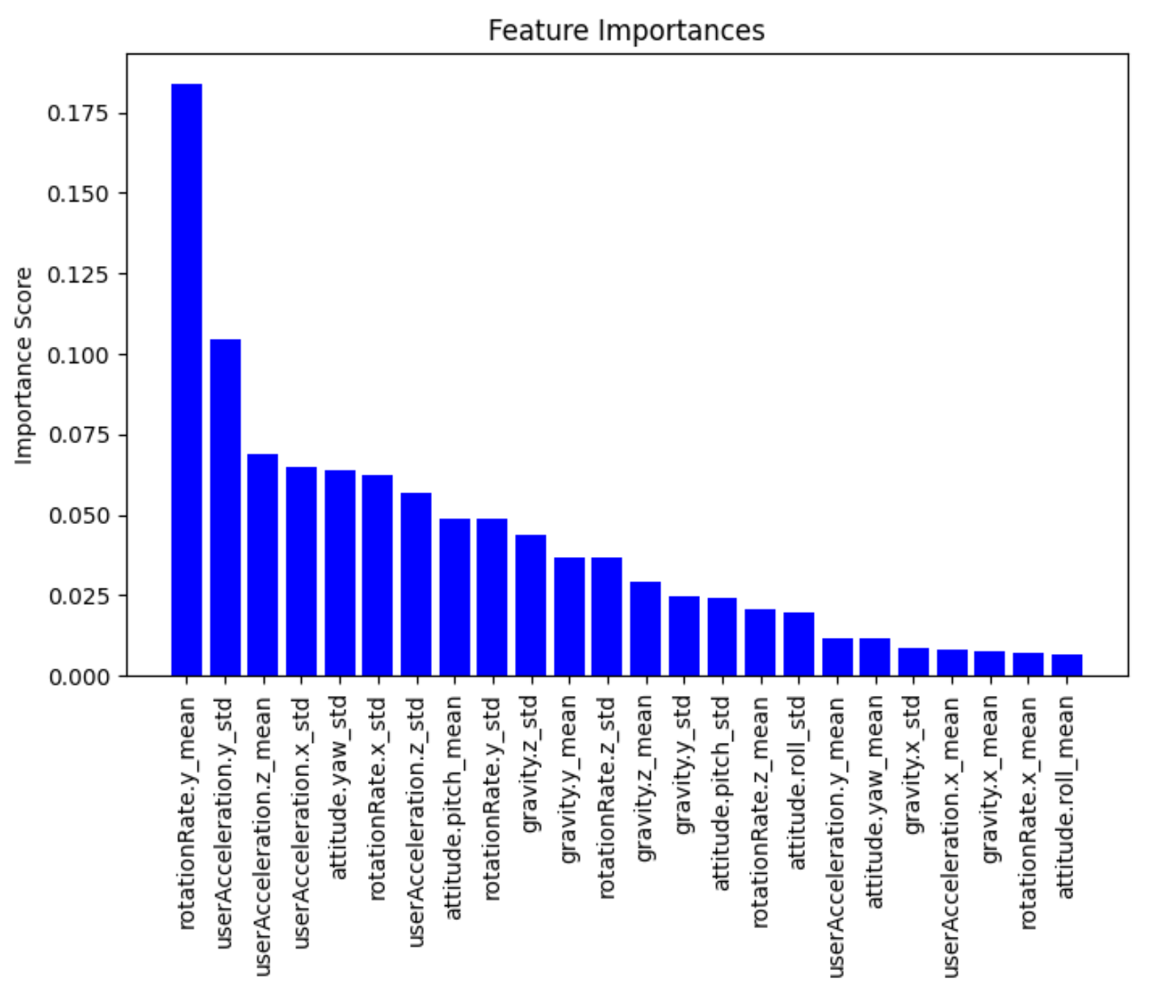
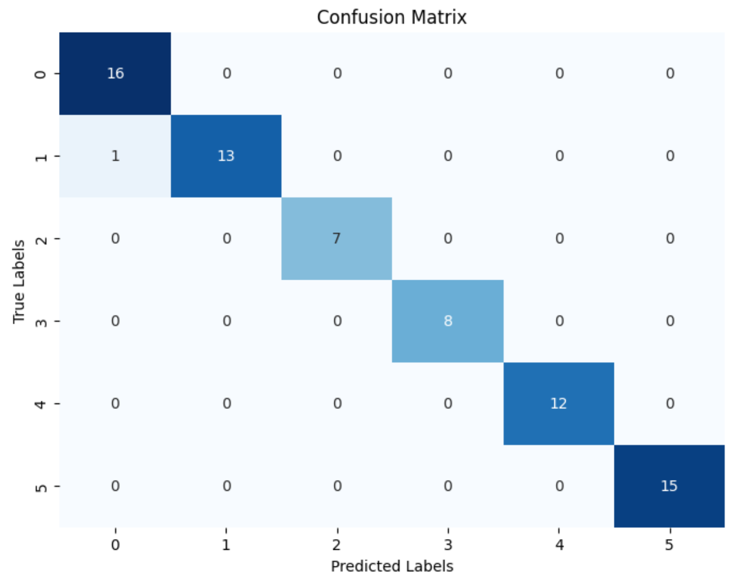
Evaluation and feature importan

Slide 7
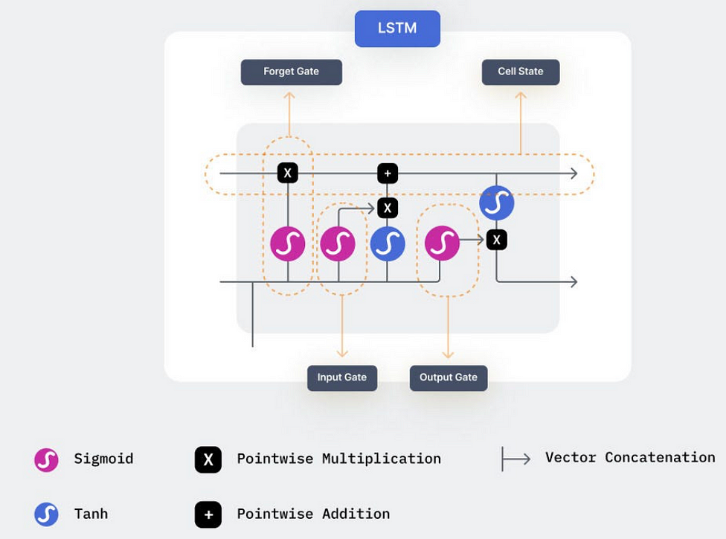
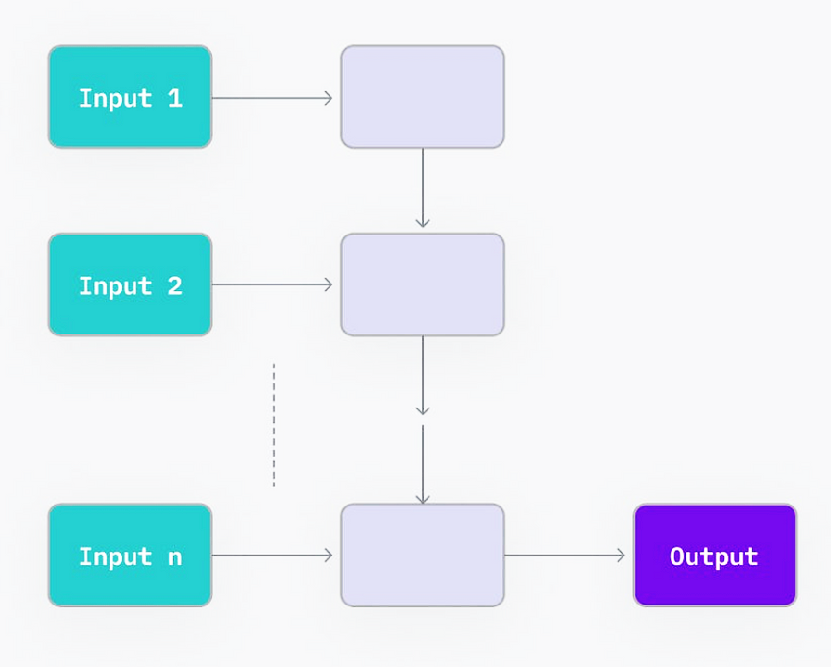
Approach (II) for model development
Implement a type of Recurrent Neural Network (RNN), called Long Short-term Memory (LSTM)
the output from the previous time step is indeed passed along with the input to the current time step. This mechanism allows the RNN to maintain memory and capture temporal dependencies
LSTM
RNN
https://vijaygadre.medium.com/recurrent-neural-networks-a-beginners-guide-16333bd2eeb1

Slide 8
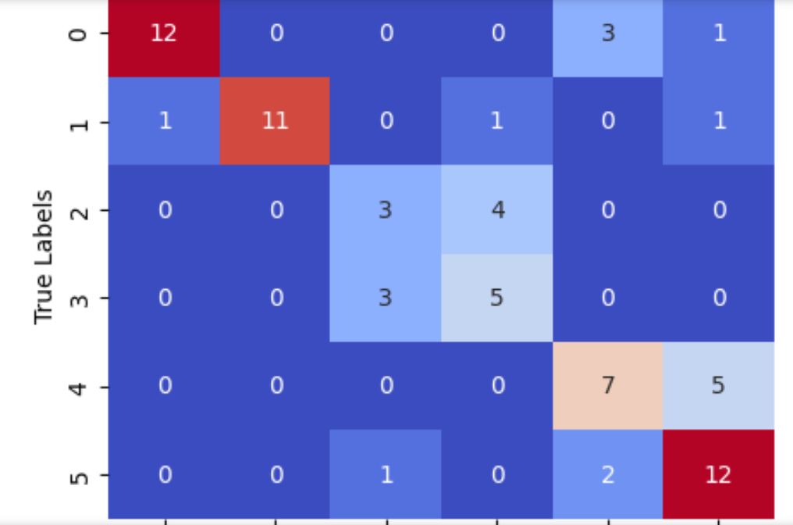
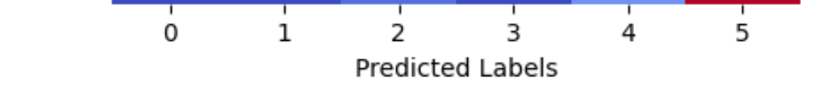
Performance results
Confusion matrix
5-fold cross-validation
Higher accuracy for the classes with larger samples in the training dataset.
Similarity between sitting and standing is captured
'dws’:0
'jog’:1
'sit’:2
'std’:3
'ups’:4
'wlk’:5

Slide 9
takeaway
Successfully trained a human activity sensing model with two approaches: traditional machine learning and neural networks
The Random Forest model trained on the mean and standard deviation of the signal resulted in 98% average accuracy in identifying the type of activity from the sensor data
The implementation of neural network demonstrates that, complicated approaches are useful only if traditional frameworks fail, large datasets and computational resources are available.

